Slide 1

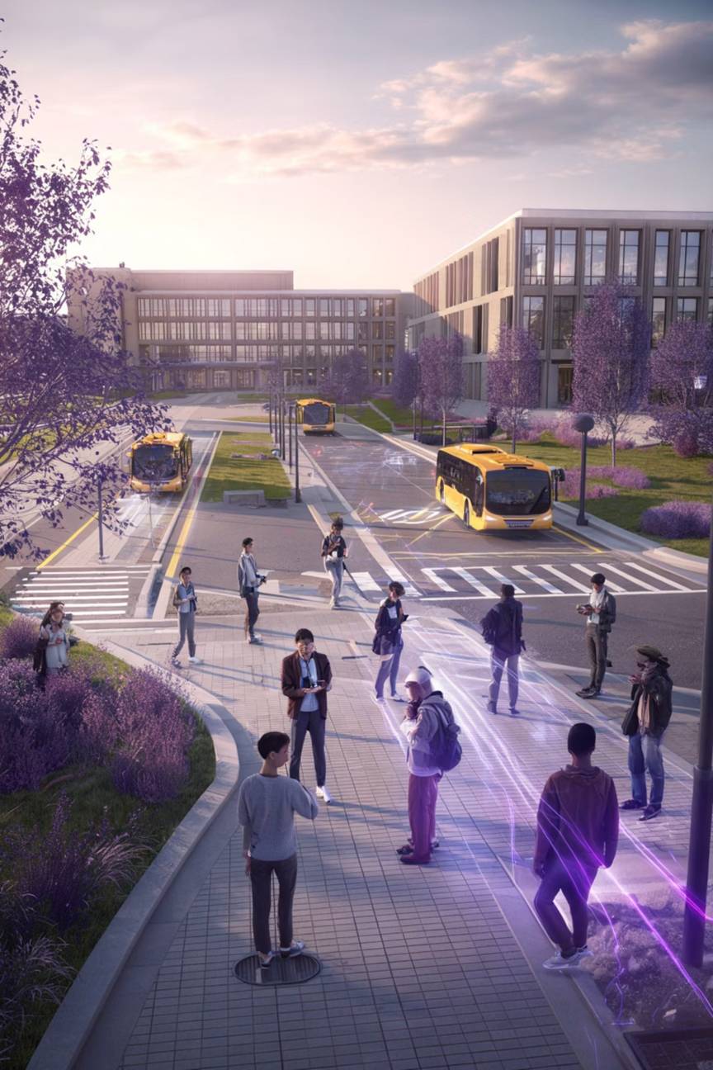
AI In Real-Time College Bus Tracking System
An innovative AI-powered solution that leverages driver smartphones for cost-effective, secure, and intelligent transportation monitoring—eliminating the need for expensive GPS hardware while ensuring authorized access through biometric verification.
Anushma S
Sathya Jyothi M
Subhashree M
Swetha C
Submitted by
Notes:
1

Slide 2

Abstract
This project introduces a revolutionary approach to college bus tracking that replaces traditional GPS hardware with smartphone technology. By combining biometric authentication, real-time location tracking, and AI-powered predictive algorithms, the system delivers accurate bus location data, route information, and arrival estimates through an intuitive web dashboard. The solution leverages Flask backend architecture, SQLite database management, and Google Maps API integration to provide students and administrators with seamless access to live transportation data while significantly reducing implementation costs.
Notes:
2

Slide 3




Problem Statement
High Implementation Costs
Unpredictable Arrival Times
Traditional GPS tracking systems require expensive hardware installation in each vehicle, creating significant financial barriers for educational institutions with limited budgets.
Students and staff lack real-time visibility into bus locations and accurate arrival predictions, leading to extended wait times and scheduling inefficiencies.
Security Vulnerabilities
Maintenance Challenges
Existing systems often lack robust authentication mechanisms, allowing unauthorized access and potential misuse of tracking data or vehicle operation.
Hardware-based GPS devices require ongoing maintenance, troubleshooting, and eventual replacement, adding to long-term operational expenses and complexity.
Notes:
3

Slide 4
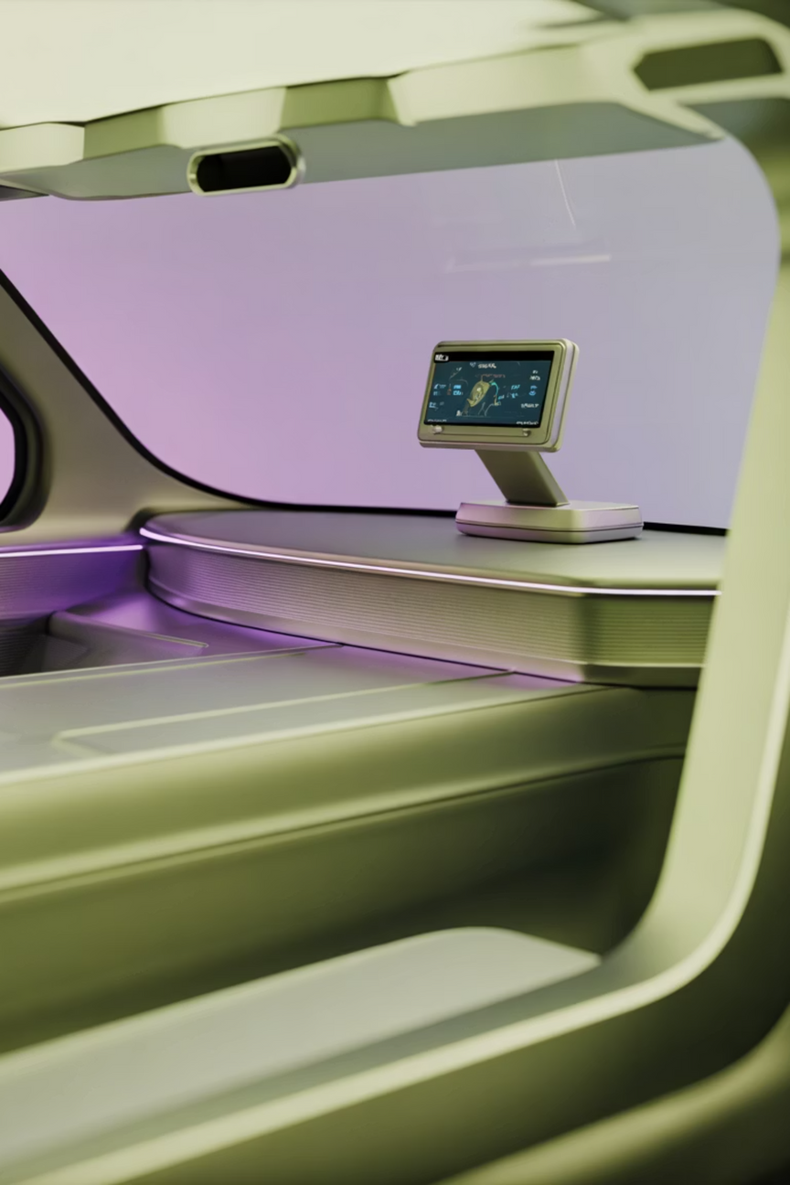
Existing System Analysis
Current Approach
Conventional college bus tracking relies on dedicated GPS hardware units installed in each vehicle. These devices transmit location data to central servers, where it's processed and displayed on monitoring platforms.
Hardware Dependency
IoT Infrastructure
Requires purchasing, installing, and maintaining GPS units for every bus in the fleet
Demands additional IoT devices and network connectivity solutions for data transmission
Limited Intelligence
Provides basic location tracking without predictive analytics or delay forecasting capabilities
Notes:
4

Slide 5

Drawbacks of Existing Systems
1
Excessive Capital Investment
GPS hardware units cost $100-$300 per vehicle, multiplied across entire bus fleets
2
Recurring Maintenance Expenses
Device failures, battery replacements, and technical support drive up operational costs
Absence of Authentication
3
No verification system to ensure only authorized drivers operate tracked vehicles
Static Data Presentation
4
Shows current location without intelligent predictions or delay analysis
Notes:
5

Slide 6
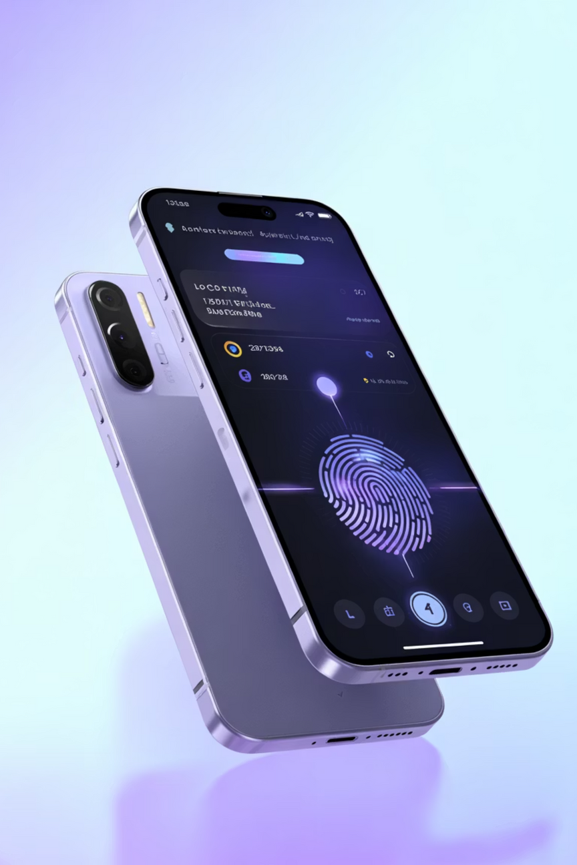





Proposed System Architecture
Biometric Verification
Driver authenticates via fingerprint before accessing tracking functionality
GPS Data Collection
Smartphone continuously transmits location coordinates to backend server
Data Processing
Flask backend stores information in SQLite and applies AI algorithms
Live Visualization
Web dashboard displays real-time location, routes, and arrival predictions
Notes:
6

Slide 7
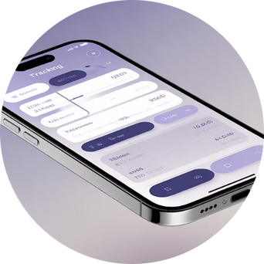
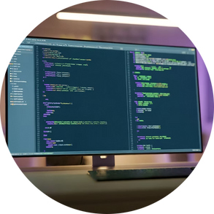

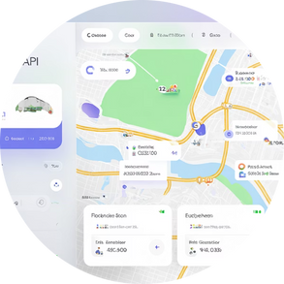

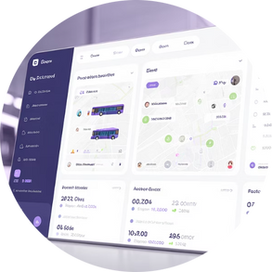
System Components & Technology Stack
Flask Backend Server
SQLite Database
Google Maps Integration
Driver Mobile
Native app with fingerprint authentication and background GPS tracking capabilities
Lightweight Python framework handling API requests, data validation, and processing
Efficient embedded database storing driver information, location history, and route data
Interactive mapping API providing route visualization and geolocation services
AI Prediction Engine
Web Dashboard
Machine learning algorithms analyzing patterns to forecast delays and arrival times
Responsive interface accessible to students and administrators for live tracking
Notes:
7

Slide 8

Advantages of Proposed System
90%
100%
85%
Cost Reduction
Driver Authentication
Prediction Accuracy
Eliminates expensive GPS hardware investment and maintenance expenses
Biometric verification ensures only authorized personnel access the system
AI algorithms deliver highly accurate arrival time estimates based on historical data
Universal Accessibility
Scalable Architecture
Web-based dashboard works across all devices—smartphones, tablets, and computers—without requiring app installation for end users.
System easily expands to accommodate additional buses, routes, or campuses without significant infrastructure changes.
Real-TimeTransparency
Students and staff gain instant visibility into bus locations, reducing uncertainty and improving campus transportation experience.
Notes:
8

Slide 9




Future Enhancements
Push Notifications
Passenger Count Integration
Automated alerts notifying students when their bus approaches their stop or experiences significant delays
Computer vision or sensor integration to track bus occupancy and provide capacity information to waiting passengers
Dynamic Route Optimization
Advanced Analytics
AI-powered route adjustment based on real-time traffic conditions, passenger demand, and schedule requirements
Comprehensive reporting on route efficiency, driver performance, fuel consumption patterns, and maintenance scheduling
Additional possibilities include multi-language support, voice assistant integration, emergency SOS features, and blockchain-based security for enhanced data integrity and privacy protection.
Notes:
9

Slide 10

Conclusion
This innovative real-time college bus tracking system demonstrates
how leveraging existing smartphone technology, combined with AI
intelligence and biometric security, can solve transportation visibility
challenges without the financial burden of traditional GPS hardware.
By integrating Flask backend architecture, SQLite data management,
and Google Maps visualization, the solution delivers a cost-effective,
scalable, and user-friendly platform that benefits students, drivers, and
administrators alike. The system's predictive capabilities and secure authentication mechanisms set a new standard for smart campus transportation management, proving that innovation doesn't require expensive infrastructure—just creative problem-solving and modern technology integration.
.
Questions and feedback welcome
Notes:
10

Slide 11
Thank you

